Slide 1

Pierce County Fair
2nd and 3rd Grade
Celebrating 250 Years 1776-2026
Celebrating 250 Years 1776-2026

Slide 2
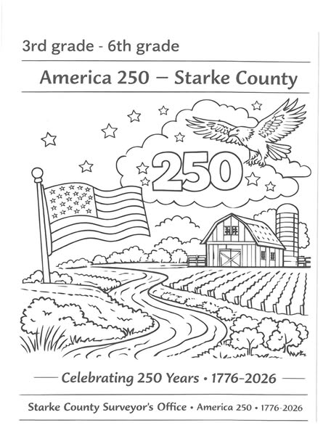
Pierce County Fair
4th Grade – 6th Grade
Coloring Page

Slide 3

Pierce County Fair
7th Grade – All Adults
Celebrating 250 Years 1776-2026

Slide 4
Pie Eating Contest – Step-by-Step Guide
1. Setup & Equipment
Contest Area:
  2 tables for contestants
  Disposable tablecloths (for easy cleanup)
  If using a trailer or stage: lay down a tarp underneath
  Bleachers or seating area for the audience
  Additional garbage containers placed around the contest area and audience seating
Food & Supplies:
  18 frozen cream pies
  Remove from freezer 3–4 hours before the event
  Keep out of direct sunlight
Weighing Station:
  1 scale
  2 tables (for weighing and storing pies)
  Location: set up behind contestants
Event Supplies:
  Stopwatch or timer
  Score sheets
  2 rolls of paper towels
  PA system (for announcements)
  Access to water (for contestant cleanup)
  Garbage containers at prep/weighing station
Prizes:
  Gift cards (local businesses work well)
Staff Needed:
  At least 7 helpers to run the event smoothly

Slide 5
2. Contest Setup
Prepare contestant tables with pies placed evenly.
Set up weighing station behind contestants.
Place garbage containers at each key location:
  Near contestant tables
  At weighing station
  Near audience area
Ensure pies are weighed before the contest begins.
Brief contestants and audience on rules.
Assign roles to helpers (timer, announcer, weigh-in staff, cleanup, etc.).
3. Rules
Weigh each pie (with container) before the contest starts.
Contestants must stand with hands behind their back at all times.
Each contestant gets 2 minutes to eat their pie using only their face.
After time is up, pies are re-weighed.
Winner = least amount of pie weight remaining.
4. Competition Format
Run contestants in rounds, depending on turnout and schedule
You can group by age categories (determined after all contestants compete)
Multiple rounds can be held if time allows

Slide 6
5. Judging & Winners
Weigh remaining pie for each contestant
Record results on score sheet
Compare weights to determine winners
Announce winners by category (if applicable)
Award prizes
6. Cleanup
Provide paper towels and access to water for contestants
Use multiple garbage containers for quick disposal of pies, plates, and towels
Replace liners as needed during the event
Dispose of tablecloths and tarp debris
Clear weighing and staging areas

Slide 7
Watermelon Eating Contest Guide
Supplies Needed (for ~30 watermelons):
30 watermelons
100 gallon-size baggies
6 coolers
Trailer or stage (optional)
Plastic sheeting or tarp (for easy cleanup)
2 tables for contestants
2 tables behind contestants (for staging food)
Disposable table covers (for contestant tables)
Bungee cords or tarp straps (to secure table covers)
Styrofoam plates
Scale (for weighing leftovers)
Stopwatch or timer
2 rolls of paper towels
Extra garbage containers
Water source nearby (for washing hands, faces, and cleanup)
Registration sheets and pens
Prizes (gift certificates ~$5, candy, toys, etc.)

Slide 8
Volunteers
Plan for 7 people to run the event smoothly:
Registration coordinator
Timer/announcer
3-4 food runners (restocking plates)
1–2 weigh-in/recording assistants
Preparation (Day Before Event)
Pick up watermelons and cut into uniform pieces
  Half-moon slices work best
Place pieces in pans as you cut
Weigh portions
  Place ~2 pounds of watermelon into each gallon bag
Store properly
  Keep bags in coolers with frozen containers (like frozen ice cream buckets filled with water)
Event Day Setup
Transport coolers to the event location
Place pre-portioned watermelon on styrofoam plates
  Store plates on tables behind contestants for easy access
Registration & Grouping
Divide contestants into age groups (adjust as needed):
  4 and under
  5–7
  8–10
  11–13
  14–17
  18+

Slide 9
Contest Rules
Eating Time
  Standard: 2 minutes
  Ages 7 and under: 1 minute with only 1 pound of watermelon
Volunteers should:
  Quickly replace empty plates
  Keep each contestant’s plates grouped together
Weighing Results
  After time is up, collect all leftovers
  Weigh remaining watermelon for each contestant
  Record results carefully
Determining Winners
Winner = least amount of watermelon remaining
(i.e., most eaten)
Awards
Distribute prizes based on number of contestants
Simple rewards work great:
  Small gift certificates
  Candy
  Toys
Cleanup Tips
Use tarps or plastic under tables for fast cleanup
Keep garbage containers easily accessible
Provide a water station for rinsing hands and faces

Slide 10
Pierce County Fair April 18, 2026
PO Box 391
Rugby, ND 58368
Dear Mark,
On behalf of the Pierce County Fair Board, I want to take a moment to sincerely thank you for the time and dedication you have given to the fair. Your willingness to serve, especially while balancing a busy schedule, has not gone unnoticed.
Your knowledge, insight, and thoughtful input have been incredibly valuable as the fair has continued to grow and move forward. The perspective you bring to the board has helped guide important decisions, and we truly appreciate the role you’ve played in that progress.
As we look ahead, we wanted to check in and see if you are interested in continuing your service on the board. We certainly value your involvement and would be glad to have you remain a part of the team.
At the same time, we understand the demands on your time. If you feel that you are unable to continue in this role, we respectfully ask that you submit a letter of resignation so that we may offer the position to someone who is able to commit to the responsibilities of board membership.
Thank you again for everything you have contributed to the Pierce County Fair. We appreciate your time, your expertise, and your commitment.
Sincerely,
Khloe Sobolik, Acting Secretary
Pierce County Fair Board

Slide 11


Slide 12


Slide 13


